Slide 1
MODULE - 5
REINFORCEMENT LEARNING

Slide 2
14.1 OVERVIEW OF REINFORCEMENT LEARNING
Reinforcement learning (RL) mimics human beings and is a branch of machine learning. Humans observe the environment through senses such as eye and ear. The inputs are processed by brain.
The brain then suggests the actions and acts voluntarily or involuntarily. In humans, learning happens in a real world called environment. Take a kid for an example.
How does the kid learn?
The kid interacts with the environment and gains valuable experience. Experience leads to learning. For example, when a kid accidently burns his hand in fire, he learns to stay away from it in the future and be careful. Similarly, the kid learns to do good things repeatedly by the encouragement or gifts given by parents or teachers.
Awards can be positive or negative. Awarding a kid is a positive reinforcement and scolding is a negative reward or deterrent as shown in Figure 14.1. Thus, kids gain experience and learn many things through rewards and punishments (negative rewards).

Slide 3
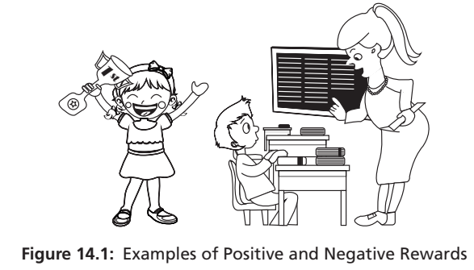
In computers, these scenarios can be simulated in many ways. As a kid executes many actions and receives a mix of positive and negative rewards that lead to gaining experience and learning, a computer program or robot can learn through experiences of simulated scenarios.

Slide 4
Thus, reinforcement learning is a mathematical framework for learning. There are two types of reinforcement learning – positive and negative.
Positive reinforcement learning is a recurrence of behaviour due to positive rewards.
Rewards increase strength and the frequency of a specific behaviour.
This encourages to execute similar actions that yield maximum reward.
Similarly, in negative reinforcement learning, negative rewards are used as a deterrent to weaken the behaviour and to avoid it.

Slide 5
In a maze game, there may a danger spot that may lead to loss. Negative rewards can be designed for such spots so that the agent does not visit that spot.
Positive and negative rewards are simulated in reinforcement learning, say +10 for positive reward and -10 for some danger or negative reward.
Reinforcement learning is an example of semi-supervised learning technique and is used to model sequential decision-making process.

Slide 6
14.2 SCOPE OF REINFORCEMENT LEARNING
What are the situations where reinforcement learning can be used? Consider the following grid game shown in Figure 14.2, where a robot can move.
Assume the starting node is E and goal node is G, the game is about finding the shortest path from starting to goal state.
Consider another grid game as shown in Figure 14.3.
In this grid game, the grey tile indicates the danger, black is a block and the tile with diagonal lines is the goal.
The aim is to start, say from bottom-left grid, using the actions left, right, top and bottom to reach the goal state.

Slide 7
Reinforcement learning is highly suitable for solving problems like this, especially the ones with uncertainty.
Reinforcement is not suitable for environments where complete information is available.
For example, the problems like object detection can be better solved using a classifier than by reinforcement learning.

Slide 8
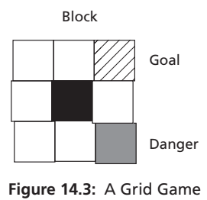
Characteristics of Reinforcement Learning
1. Sequential decision making – Consider the Figure 14.3. It can be seen the path from start to goal is not done in one step. It is a sequence of decisions that leads to the goal. One wrong move may result in a failure. This is the main characteristic of reinforcement learning.
2. Delayed feedback – Often, rewards are not immediate. One must spend many moves to get final success or failure. Feedback in terms of reward is often delayed.
3. The agent actions are interdependent as any action affects the subsequent actions. For example, one wrong move of an agent may lead to failure.
4. Time related – All actions are associated with time stamps inherently as all actions are ordered as per the timeline inherently.

Slide 9
Challenges of Reinforcement Learning
1. Reward design is a big challenge as in many games, as determining the rewards and its value is a challenge.
2. Absence of a model is a challenge – Games like chess have fixed board and rules. But, many games do not have any fixed environment or rules. There is no underlying model as well. So, simulation must be done to gather experience.
3. Partial observability of states – Many states are fully observable. Imagine a scenario in a weather forecasting where the uncertainty or partial observability exists as complete information about the state is simply not available.
4. Time consuming operations – More state spaces and possible actions may complicate the scenarios, resulting in more time consumption.
5. Complexity – Many games like GO are complicated with much larger board configuration and many possibilities of actions. So, labelled data is simply not available. This adds more complexity to the design of reinforcement algorithms.

Slide 10
Applications of Reinforcement Learning
There are many applications of RL. Some of the application domains where reinforcement learning is used are listed below:
• Industrial automation
• Resource management applications to allocate resource
• Traffic light controller to reduce congestion of traffic
• Personalized recommendation systems like news
• Bidding for advertisement
• Customized applications
• Driverless cars
• Along with deep learning games like Chess and GO
• Deep mind applications like to generate programs and images

Slide 11
14.3 REINFORCEMENT LEARNING AS MACHINE LEARNING
In supervised learning, there is a supervisor but in reinforcement learning the supervisor is absent. Supervised learning learns using labelled data. It maps the input to fixed, pre-defined output. Supervised learning has a luxury of labelled data. In reinforcement learning, there is no labelled data. Instead, the labels are generated by the interaction of the agent with the environment. The agent may be a human or a computer program such as a chatbot. It can be obvious that games like Chess and GO cannot be solved using supervised learning as training dataset of these games cannot be generated.

Slide 12
In the absence of the training set, the only option left is reinforced learning where the agent can interact with the environment and learns by trial and error.
Thus, one can observe the difficulties faced by reinforcement learning when compared with other machine learning algorithms.
In supervised classifiers, the choice is one-shot, say cancer or not cancer.
But in reinforcement learning, it is a sequential decision making, say finding the path from start to goal state.
One must wait for more moves to see success or failure. The reason behind success and failure is found by observing the patterns over a long time and these decisions have longer consequences.
For example, in a game, one wrong move may result in failure.

Slide 13
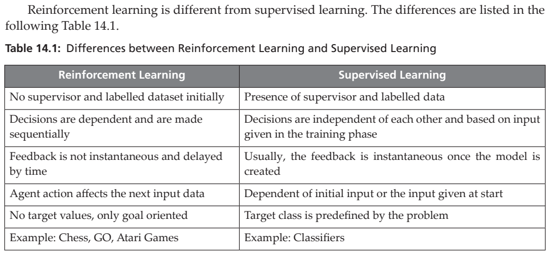

Slide 14
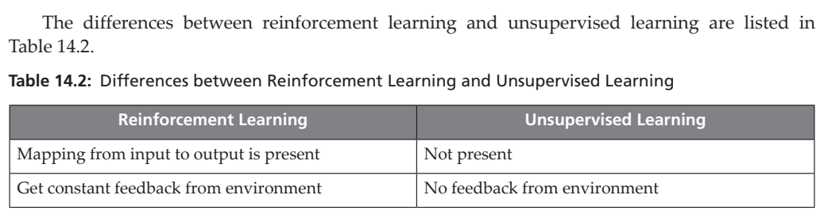

Slide 15
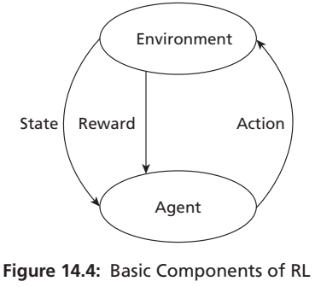
14.4 COMPONENTS OF REINFORCEMENT LEARNING
The components of reinforcement learning are shown in Figure 14.4. These are environment, agent, actions and rewards.

Slide 16
Reinforcement Problems
There are two types of problems in reinforcement learning – Learning and Planning.
In learning problems, the environment is unknown and the agent learns by trial and error.
The agent interacts with the environment to improve policy. Planning is another problem where the environment is known and the agent computes with the model and improves policy.

Slide 17
Environment and Agent
Environment is the world where all actions take place. It is the framework, where the input, output and reward are specified. The environment describes the state or state variables or simply as state. Initially, the environment is in a state called initial state. For example, in a car system, the maps, game rules and obstructions in the road are described in the environment. An agent is an autonomous body that looks at the environment and takes an action. It can be any human or another computer program such as a robot or chatbot.

Slide 18
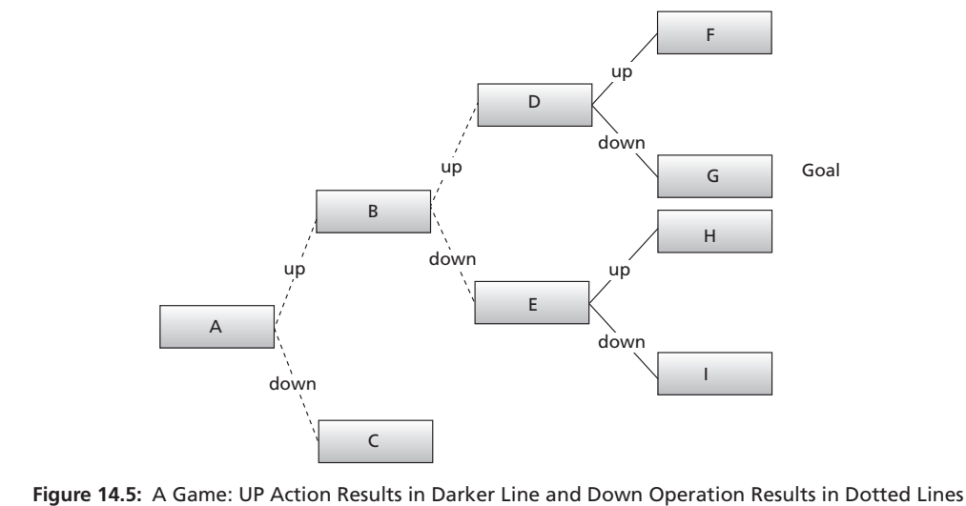
States and Actions
The input for reinforced learning is called a state and the output is action. Consider the following graph in Figure 14.5 generated by two actions, up and down, by an agent.

Slide 19
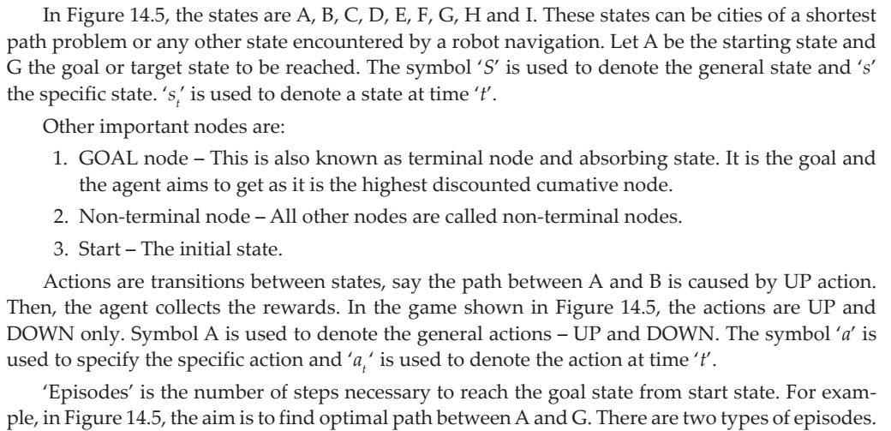

Slide 20
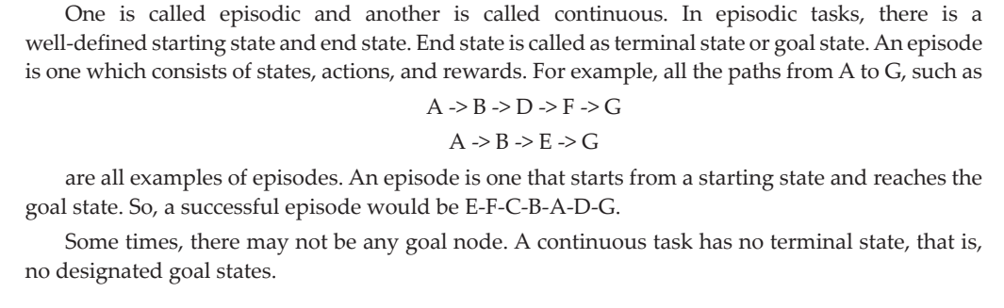

Slide 21
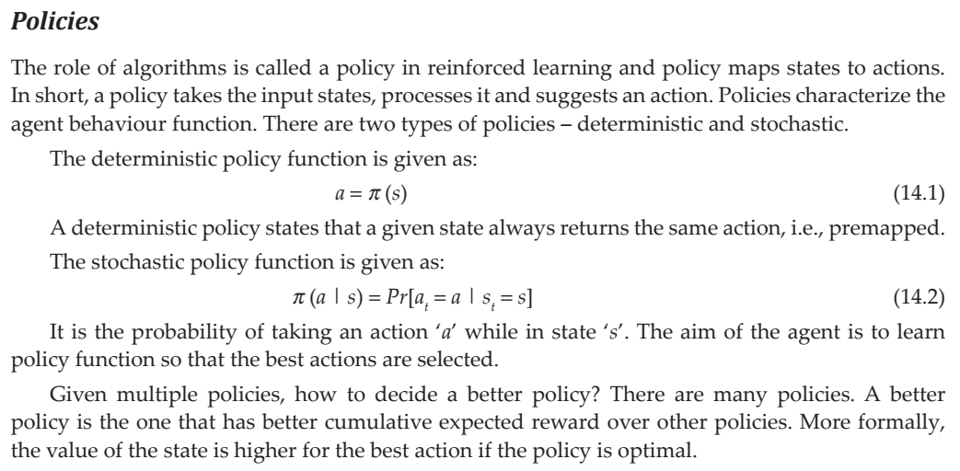

Slide 22
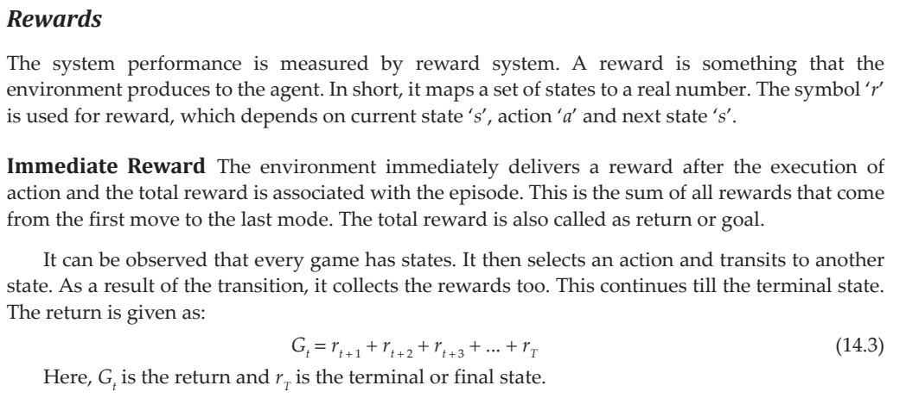

Slide 23
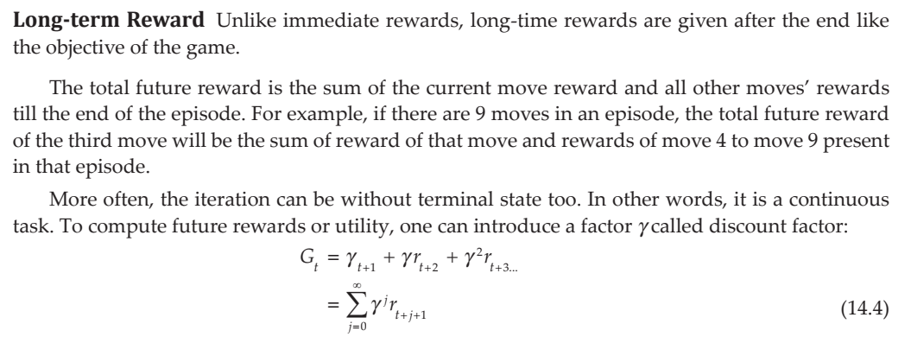

Slide 24
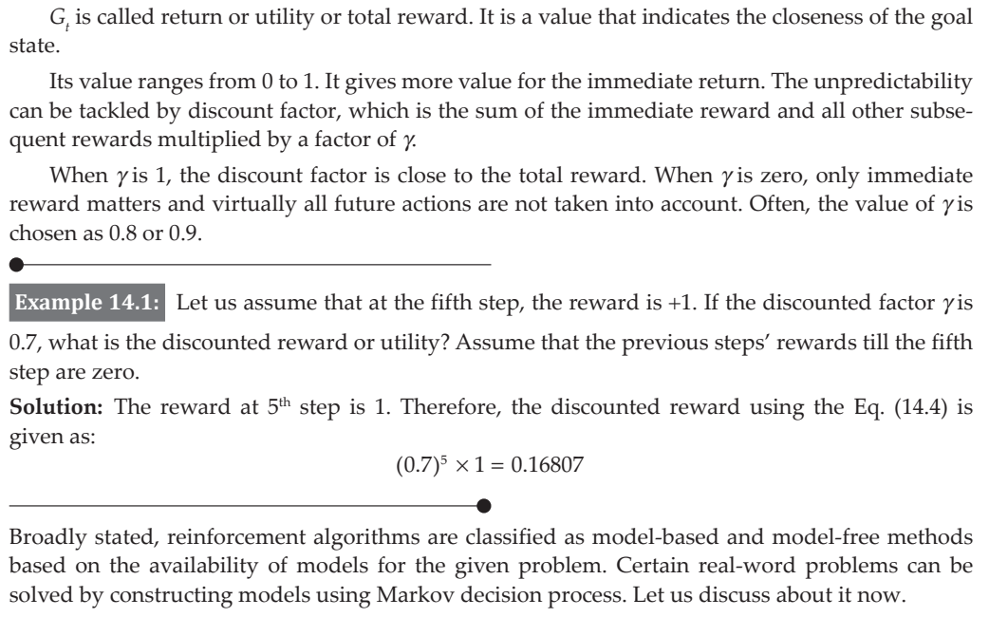

Slide 25
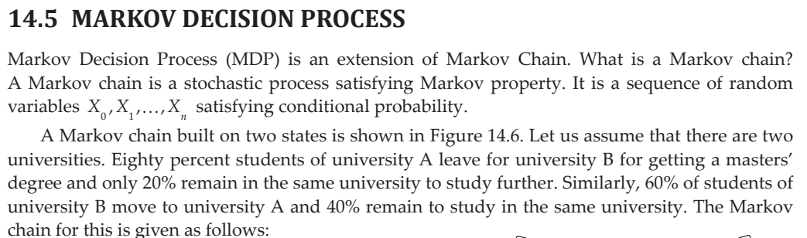

Slide 26
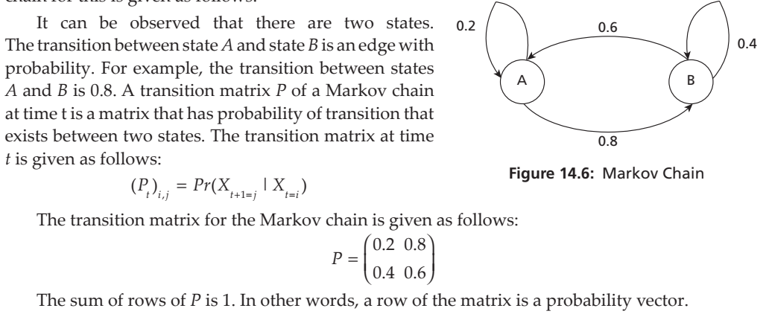
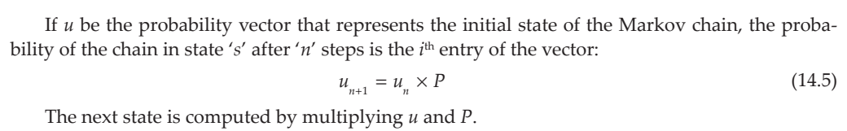

Slide 27
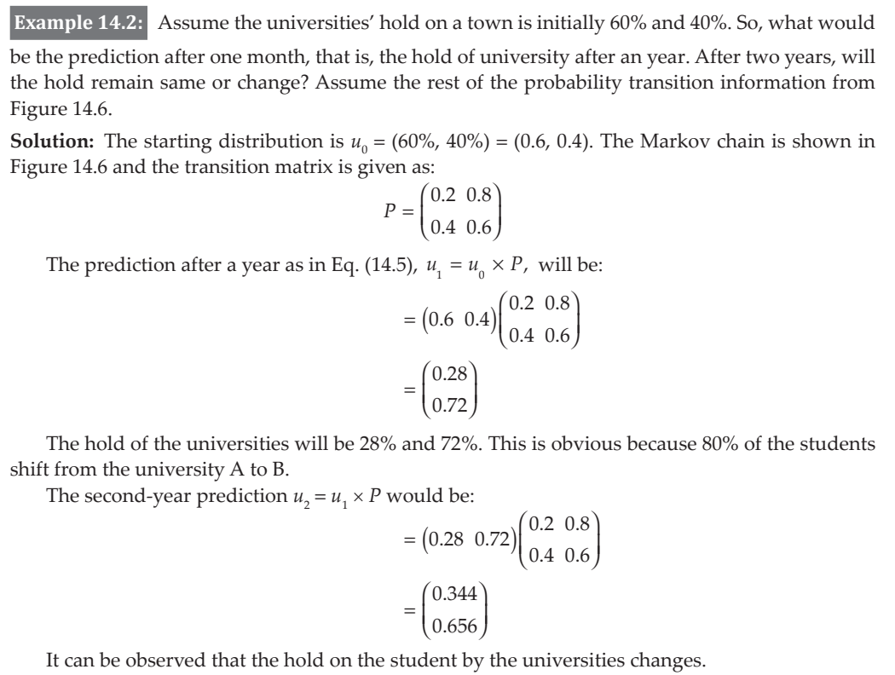

Slide 28
If rewards are added to markov chain, the markov decision process is obtained where the edges are associated with probability as well as reward.
As discussed earlier, MDP is an extension of Markov Chain. The components of MDP are:
1. A set of states
2. A set of actions
3. Reward Function R
4. Policy p
5. Value V
The simplest structure of MDP is Markov chain where the environment is modelled as a graph.
The nodes of the graph represent states and edges represent transitions. Each edge is associated with a static probability.

Slide 29
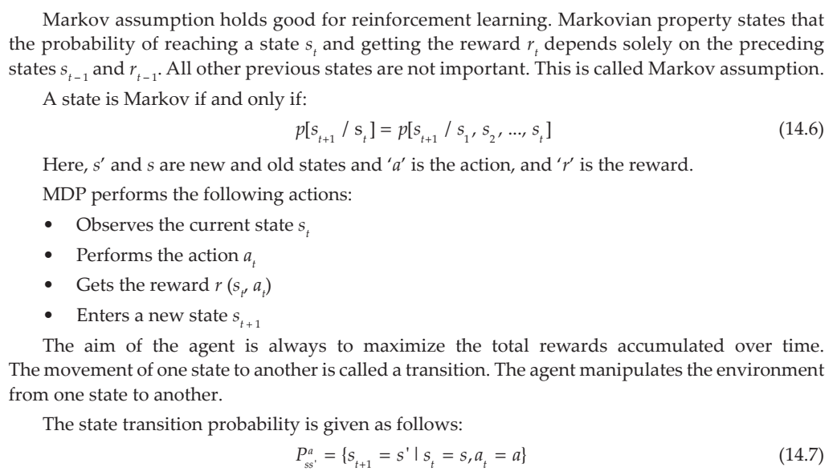

Slide 30
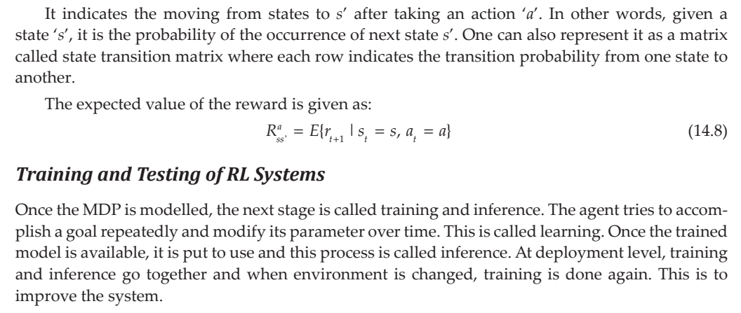

Slide 31
14.6 MULTI-ARM BANDIT PROBLEM AND REINFORCEMENT PROBLEM TYPES
Reinforcement learning uses trial and error to learn a series of actions that maximize the total reward. There are two sub-problems in the reinforcement problem.
1. The main problem is the prediction of total reward or return. This is called prediction, policy evaluation or value estimation. It requires a formulation of a function called statevalue function. The problem of estimating the state value function can be done using temporal differencing or TD-Learning.
2. The second problem is finding actions that maximize the returns. It is called policy improvement. Both these things can be combined as policy iteration which alternatively uses the above to find optimal policy.

Slide 32
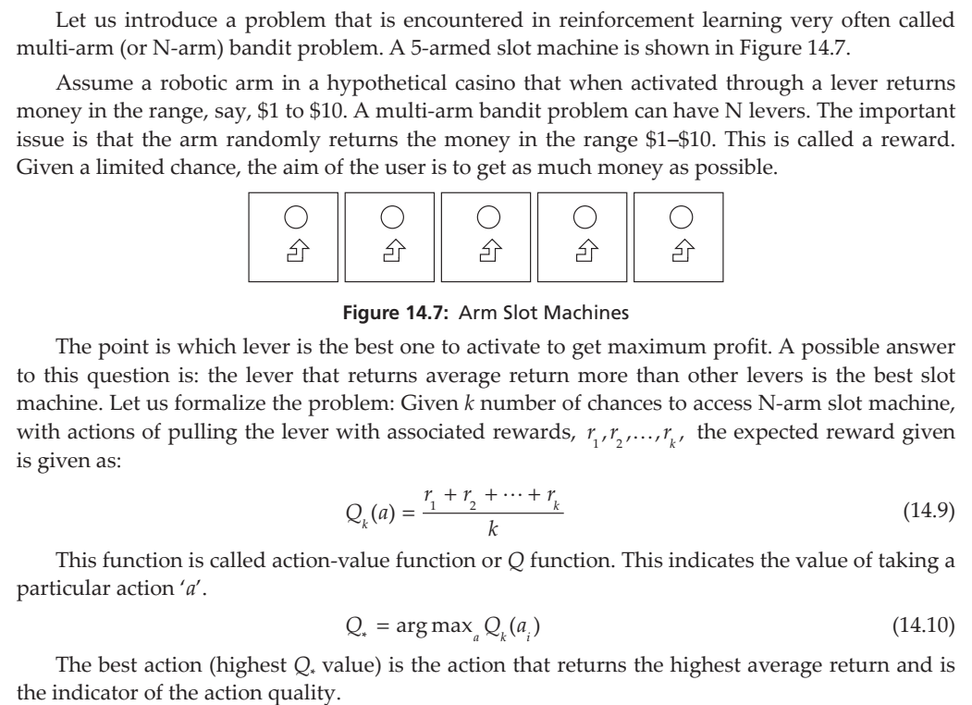

Slide 33
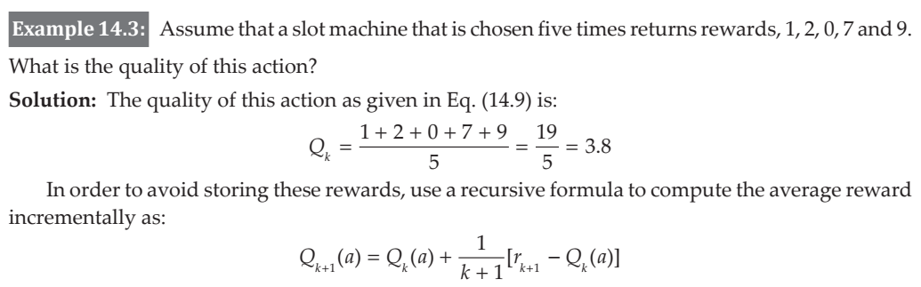
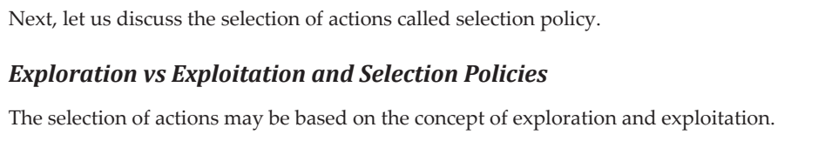

Slide 34
Exploration
The method explores all actions even if it results in sub-optimal decisions. It is considered to be an adventurous method. In games, it works by exploring all actions and observing rewards.
Exploitation
It is a naïve approach that uses current knowledge and keeps exercising those options repeatedly. Its aim is to choose only one action based on experience and always get the same reward. This is not adventurous and is mostly suboptimal. There must be a balance between exploration and exploitation for selection. Based on these principles, selection policies can be designed.

Slide 35
Greedy Method
In the absence of any knowledge, picking the best action as of now is called greedy method. This is based on the principle of exploitation. The information about greedy approach is given in Box 14.1. In a multi-arm bandit problem, initially all levers are tried. The agent notes down all the rewards that are returned by these levers. By learning the lever that returns the maximum rewards, the agent then uses it repeatedly to reap maximum reward. Say, for example, if the fifth lever returns more money, then the same lever is pressed again and again to get maximum reward. This is called greedy approach and hence there is no exploration part. For example, eight levers might have returned more, but one may never know due to the experience with the fifth lever.

Slide 36
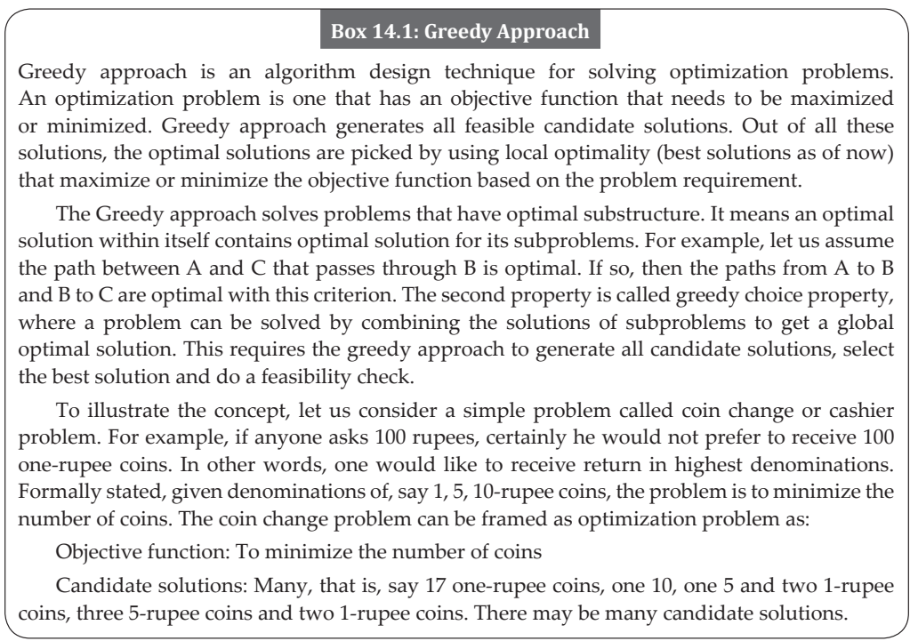

Slide 37
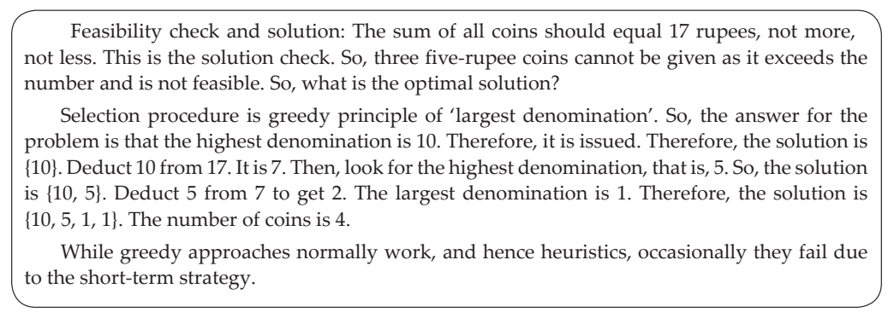

Slide 38
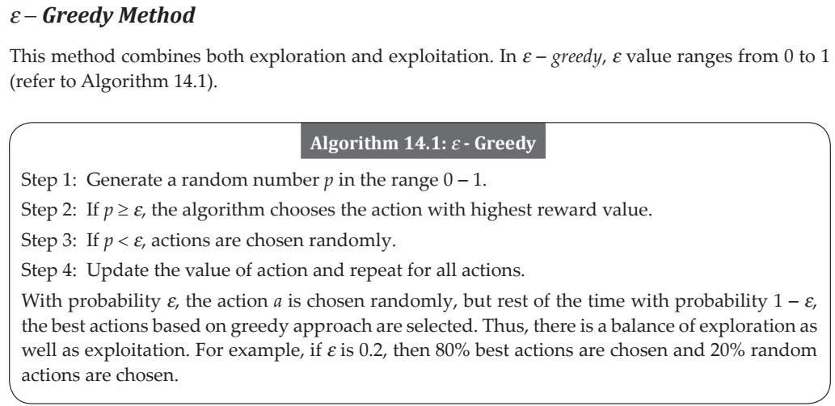

Slide 39
Reinforcement Agent Types
An agent can be characterized using these methods:
Value-based approaches
Policy-based approaches
Hybrid methods
Model-based methods
Model free methods
Value-based Approaches The aim of value-based approaches is to optimize V (s). Here, V (s) is a function that returns the maximum expected future reward the agent will get at each state discounted by a discount factor lamda. This value is then used to select the state for the agent. A large value is chosen by the agent to pick the state.

Slide 40
Policy-based Approach
The aim is to find an optimal policy. A policy p is a strategy. A policy is a function that maps a state to a probability distribution of all possible actions in that strategy. It aims to find the optimal policy to map each state to best action.
Actor Critics Methods
These are hybrid methods combining both value-based and policy-based methods.
Model-based Approach
First, the model is constructed for the environment as it is available. Markov Decision process is one way of modelling the given problem.
Model-free Methods
Here, models are not available and hence some methods are used to simulate the model virtually. The techniques like temporal differencing and monte-carlo methods are generally used to simulate such models. These techniques are discussed in section 14.8.

Slide 41
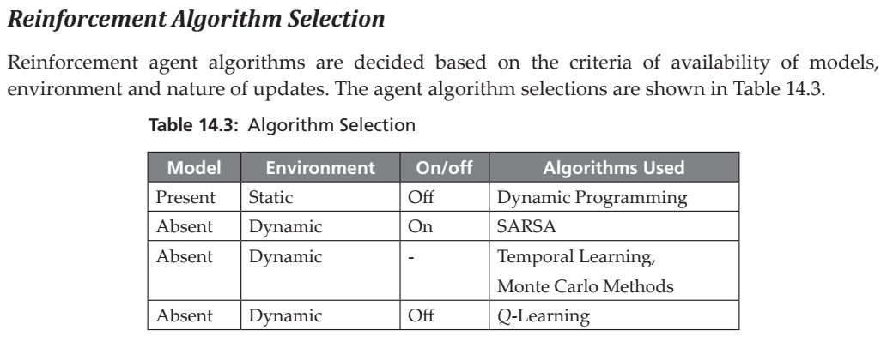

Slide 42
14.7 MODEL-BASED LEARNING (PASSIVE LEARNING)
Passive Learning means model-based environment, which is based on known environment. By known environment, it means that for any state, the next state and action, the probability distribution is known.
Markov Decision Process (MDP) and dynamic programming are excellent tools for solving reinforcement problems.
The mathematical framework required for passive learning is provided by Markov Decision Process.
These model-based reinforcement problems can be solved using dynamic programming (refer to Box 14.2) after the construction of the model using MDP.

Slide 43
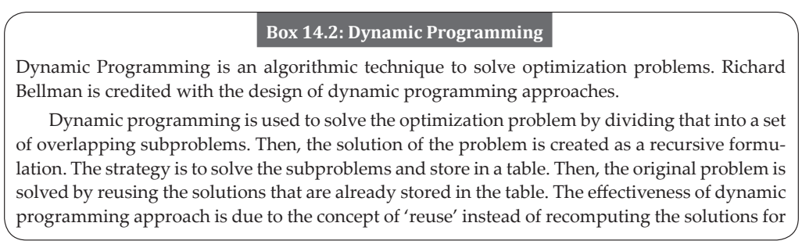

Slide 44
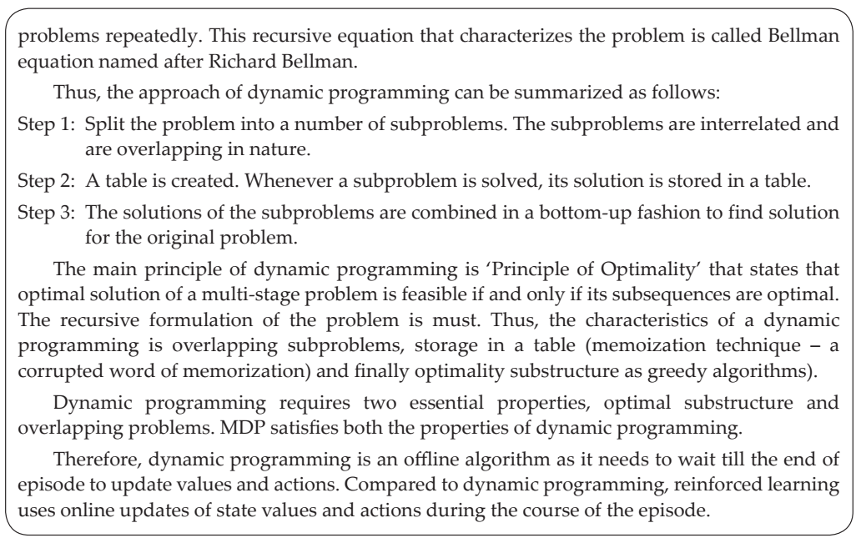

Slide 45
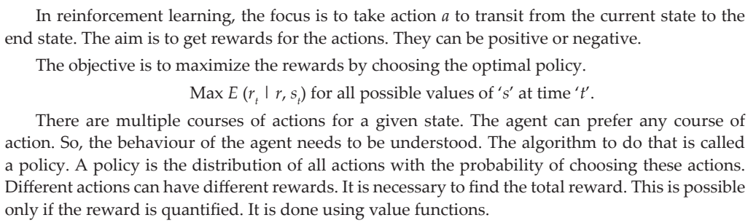

Slide 46
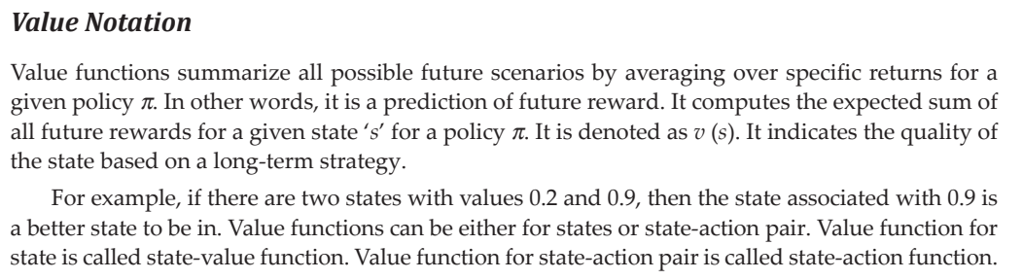

Slide 47
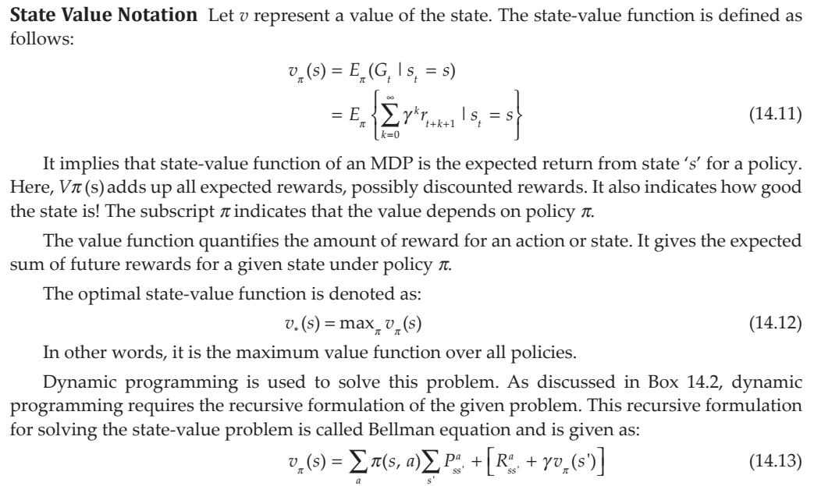

Slide 48
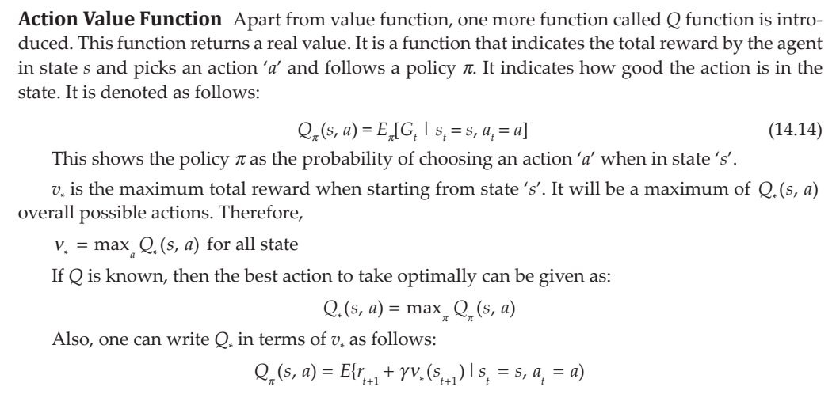

Slide 49
Algorithms for Solving Reinforcement Problems using Conventional Methods
After defining the state-value and action-value functions, one can define the algorithms to solve reinforcement problems.
There are two types of algorithms:
1. Value Iteration
2. Policy Iteration

Slide 50
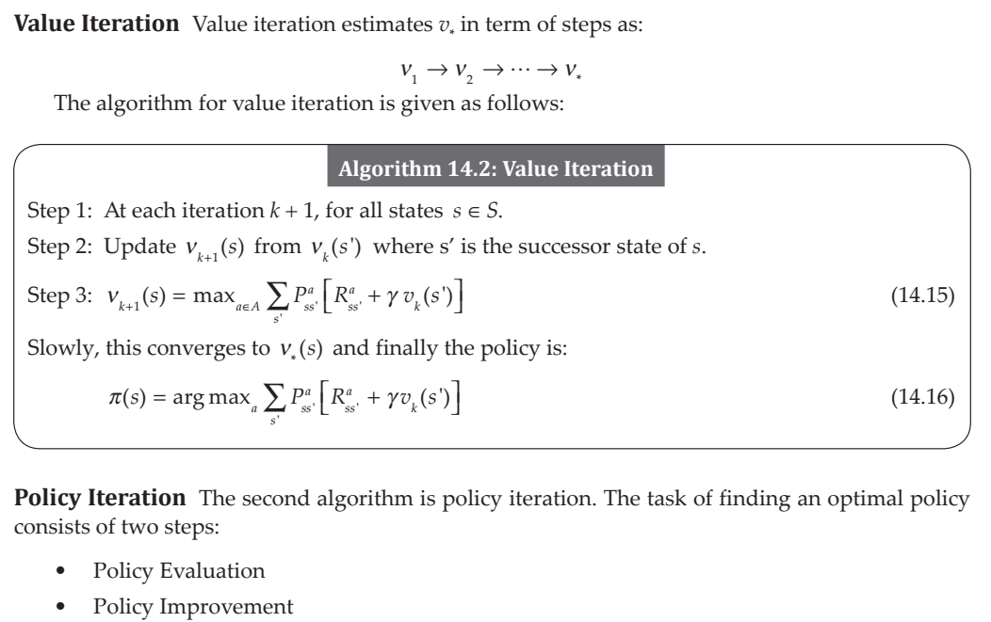

Slide 51
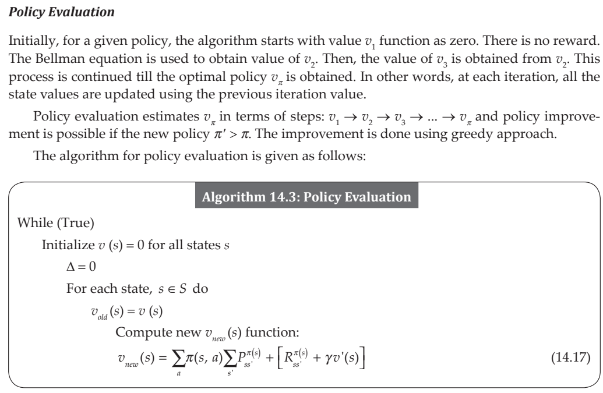

Slide 52
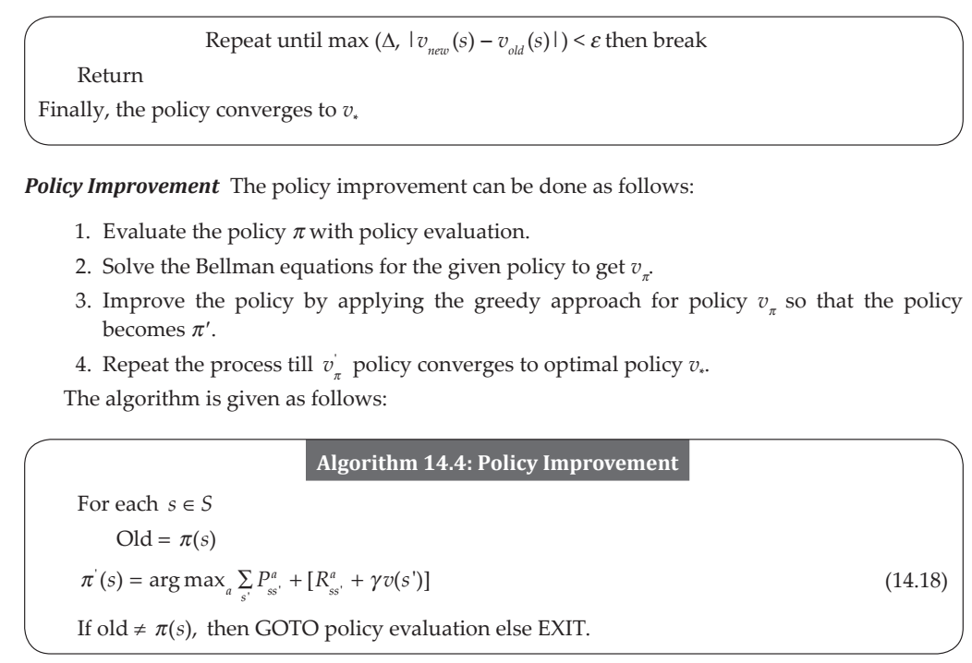

Slide 53
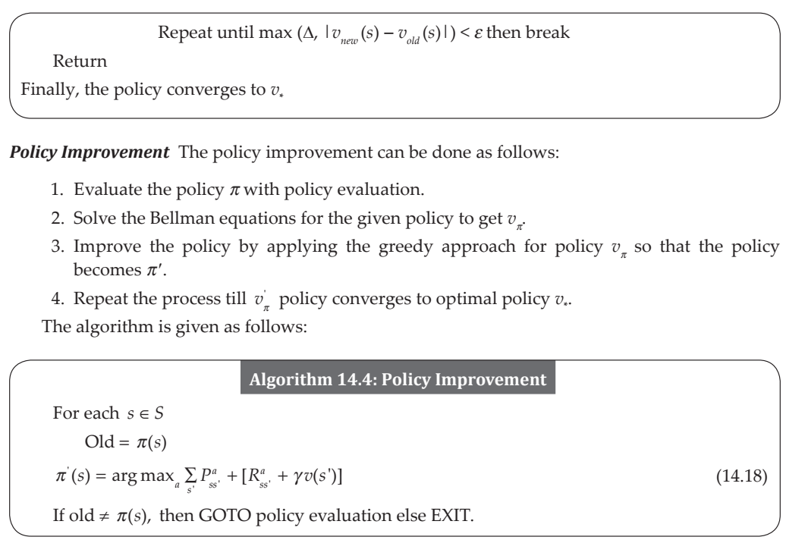

Slide 54
14.8 MODEL FREE METHODS
In model free methods, there is no complete knowledge of the environment.
So, how to determine the rewards then? The simplest formulation is the method called episodic formulation.
Recollect from section 14.2 that an episode is the path from start to the goal node. For example, the shortest path between state A to state G in Figure 14.5 is called an episode.
The simplest way to determine rewards is to play the game.

Slide 55
If the game ends in win, then all actions that are encountered in the episode are given a reward, say +1. If the game is lost, then all actions are given a value of -1.
The only problem is that the game may be lost due to the last bad move while all other actions may be good.
The second method is the continuous formulation. Here, the reward is determined after the action.
For example, in multi-arm bandit problem, the immediate reward of $1 - $10 can be an example of continuous formulation. If the actual value is not known, then it can be estimated. The third formulation is the discounted returns. The discounted return computed as the long-term reward can be one solution.

Slide 56
Some of these techniques are used in these model-free techniques such as:
1. Monte carlo (MC) methods
2. Temporal Difference Learning One of the simplest ways of simulating a model is by using Monte-Carlo methods. This is dicussed in the subsequent section.
14.8.1 Monte-Carlo Methods
Monte Carlo (MC) methods do not assume any model. Therefore, complete knowledge of the environment is not available.
This is similar to human and animal experience where the knowledge is gained by experience, and experience is gained from the interaction with the environment. MC uses the methods of experience as well as simulation to gain knowledge of the environment.

Slide 57
The experience is divided into many episodes. An episode, as discussed earlier, is a sequence of states from starting state to goal state.
MC makes the following assumptions:
1. All episodes should terminate. No matter from where we start, the episode should end.
2. MC methods use value-action functions. These values are computed only after the completion of the episode. So, MC methods are incremental methods. The MC method collects the reward at the end of the episode. Then, it is used to find maximum expected future reward. This method does not use expected return. Instead, it uses the empirical mean as return. The total return over many episodes divided by the number of episodes gives the average, alternative way to count every time a state is encounted and reward until termination.

Slide 58
14.8.2 Temporal Difference Learning
Temporal Difference (TD) learning is an alternative of Monte Carlo method. It is model free. It learns from environment based on experience and interaction as MC methods are based on the principle of bootstrapping.
TD is called bootstrapping method because the update is based on the existing estimate and future reward.
The difference is the updated new estimate. In TD method, in every stop an estimate of the final reward is calculated at each state. Then, immediately the stateaction is updated for every step.
Unlike Monte Carlo method that computes the rewards at the end of the episode, TD Learning computes the rewards at every step. The difference is listed in the following Table 14.4.

Slide 59
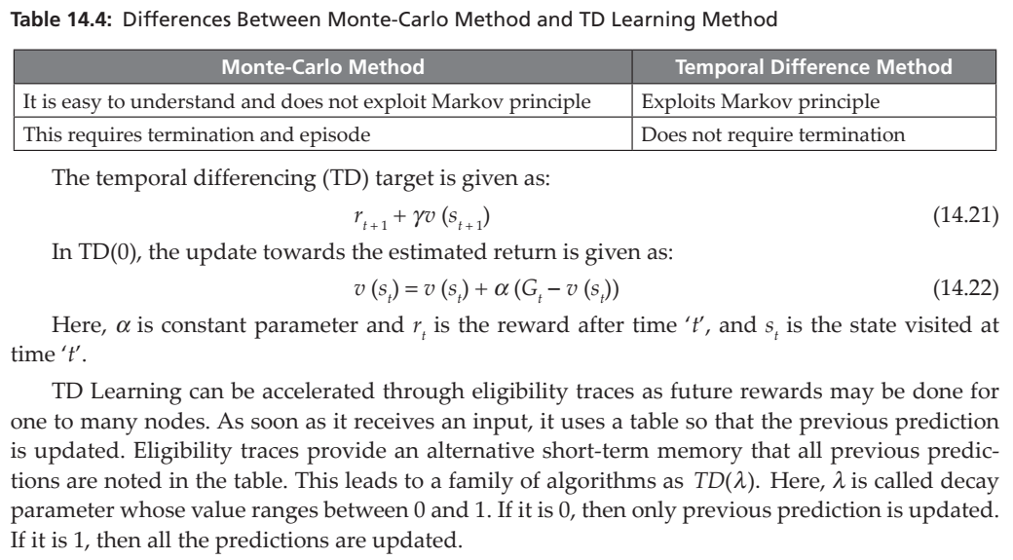

Slide 60
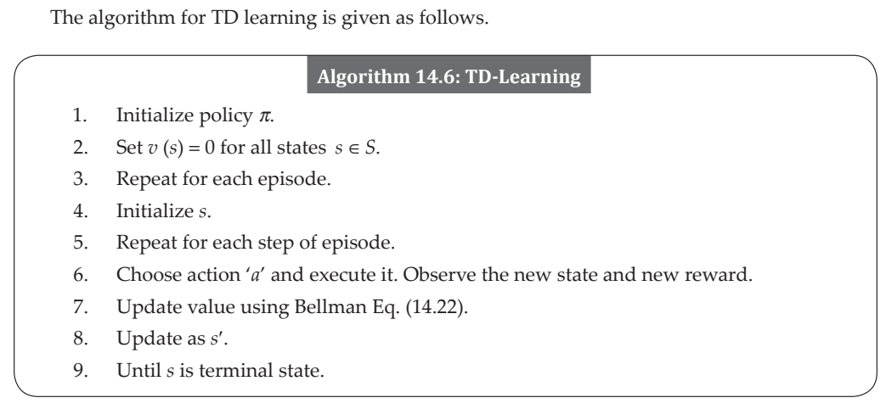

Slide 61
14.9 Q-LEARNING
Q-Learning is an off-policy method because Q is updated based on policies that are implicit to Q and is better guaranteed for maximum returns. Q indicates Quality.
What is Q-value? Q (s, a) is a numerical value assigned to a state-action pair. It means a value of the action that is performed in state ‘s’. Here, the main objective is to find Q-Value?
Q-value is nothing but the immediate reward and other rewards that are yet to come, known as total return reward.
To compute the total return reward, these information are necessary.
1. Starting state
2. Action
3. Reward
4. New state

Slide 62
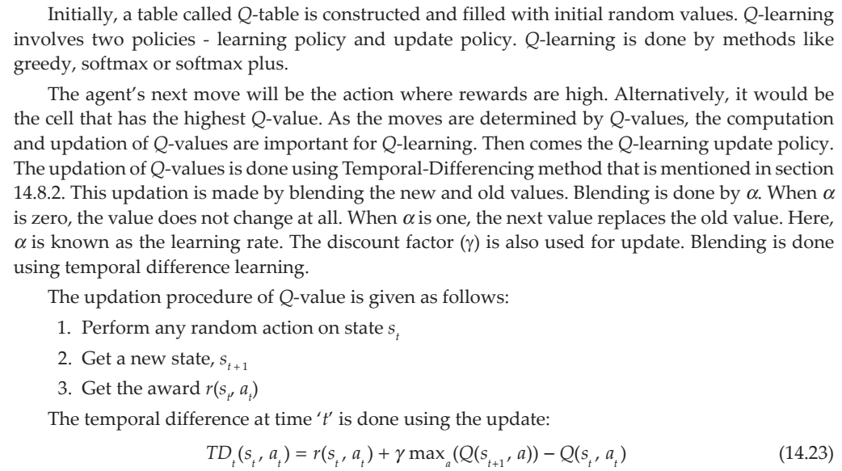

Slide 63
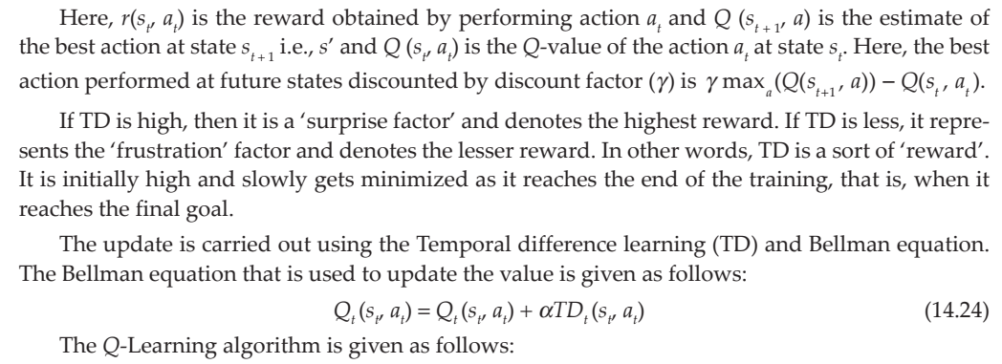

Slide 64
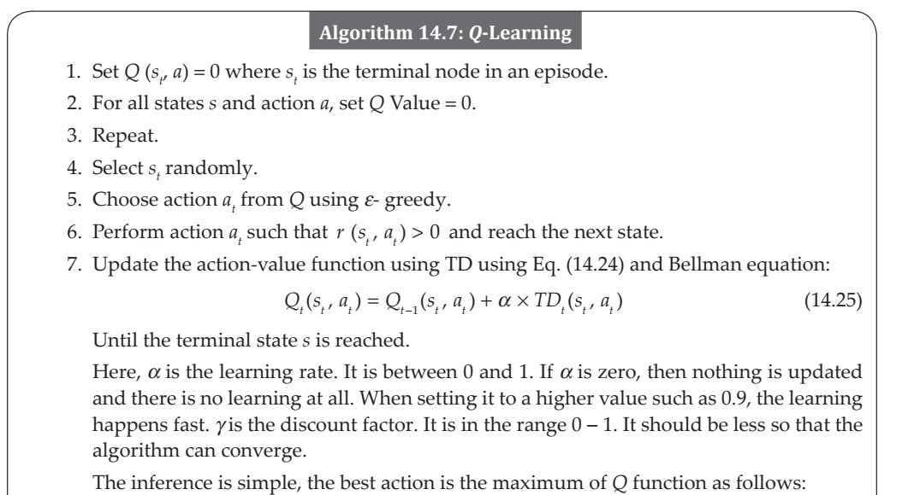

Slide 65
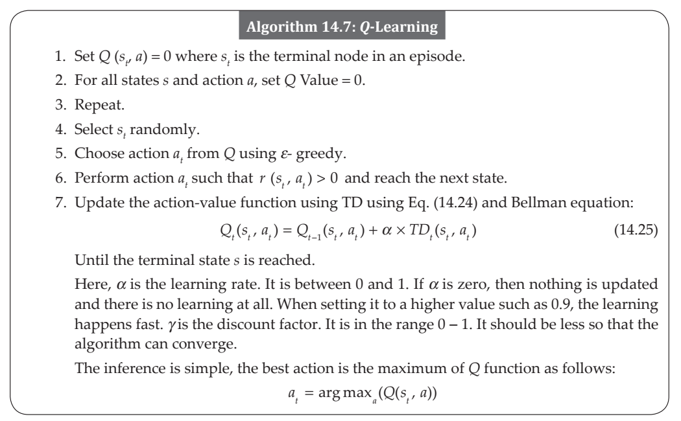

Slide 66
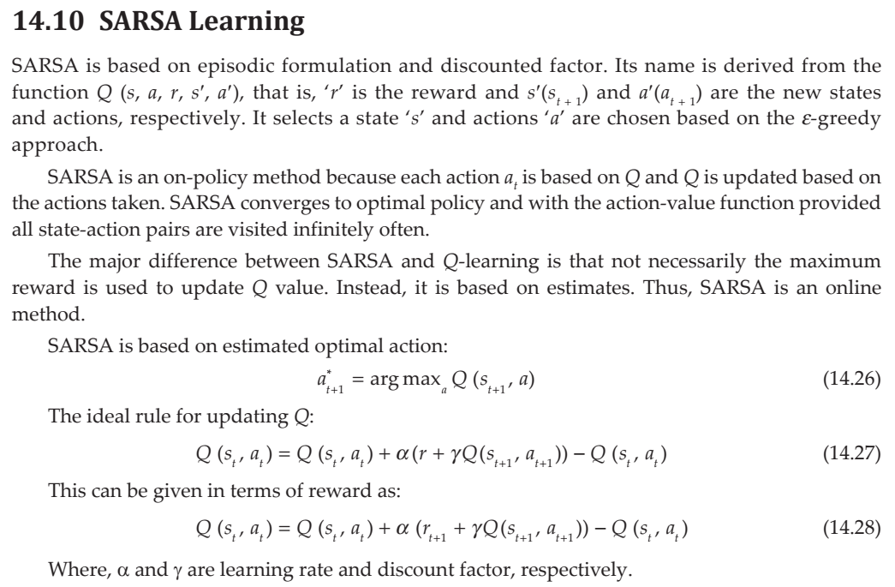

Slide 67
